Slide 1

Design Optimization Ehsan Yazdian

Slide 2
Introduction
Tool optimizations are often not good enough to meet most design constraints if an arbitrary coding style is used.
Three primary physical characteristics which should be optimized:
Speed
Area
Power
Implementation Tradeoffs
Definitions of speed (depending on the context of the problem)
Throughput
Latency
Timing

Slide 3
Defining the metrics
Throughput: Amount of data that is processed in one clock cycle
Metric: bits per second
Goal: High-throughput architectures
Latency: The time between data input and processed data output
Metric: time or clock cycles
Goal: Low-latency architectures
Timing: The logic delays between sequential elements
Metric: clock period and frequency
Goal: Reduce the combinatorial delay of the critical path
Has been discussed in previous sessions as combinatorial delay, clk-to-out delay, routing delay, setup timing, clock skew and ….

Slide 4
High Throughput Design
Concerning the steady-state data rate not latency.
Ford idea: Assembly line
In the world of digital design we refer to this term as: pipeline
The beauty of a pipelined design is that new data can begin processing before the prior data has finished, much like cars are processed on an assembly line
Pipelines are used in nearly all very-high-performance devices
CPU instruction sets
network protocol stacks
encryption engines
…..

Slide 5
Pipelining
Consider a circuit that does N operations per clock cycle at a frequency F. This design performs N*F ops/second.
Pipelining is a technique to trade latency and area to improve throughput by increasing F.
What sets the maximum frequency?
The maximum delay between flip flops!

Slide 6
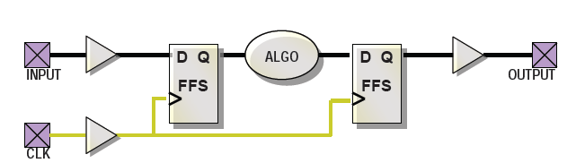
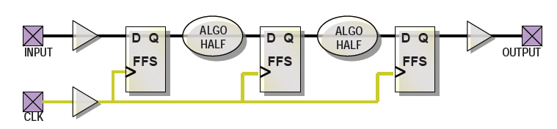
How Pipelining Improves the Throughput?
What causes delay between flip flops?
Combinational logic to implement the algorithm.
Wires for distributing signals.
Timing characteristics of the flip flops themselves. (Setup time, ...)
Partitioning the design into two pieces, with each piece contributing 1/2 of the total delay
Inserting FF’s in middle

Slide 7
Pipelining
Results…
Frequency increases; the critical paths are halved.
Latency in cycles increases; not obvious yet but the latency in real (elapsed time) also increases.
Area increases; more flip flops required.
What if you partitioned into M equal stages?
Ideally, your new throughput is N*F*M ops/sec, but …

Slide 8
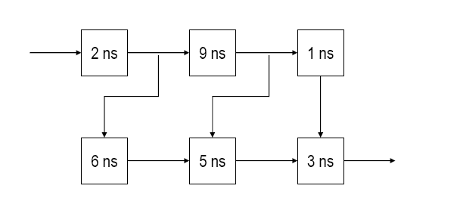
Pipeline Example
Individual functions are marked with their delay and cannot be further divided.
Where is the best points to insert pipelining flip flops?

Slide 9
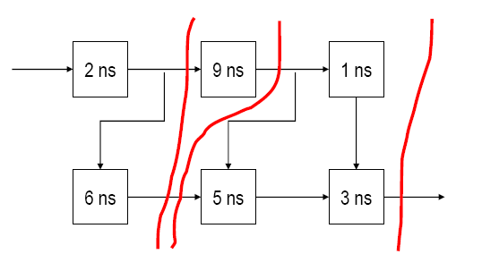
Cont.
Some signal paths need two flip flops to keep information flow synchronized.
Old Latency = 19 ns
Old Throughput = 1 op / 19 ns
New Latency = 27 ns (3 cycles)
New Throughput = 1 op / 9 ns

Slide 10
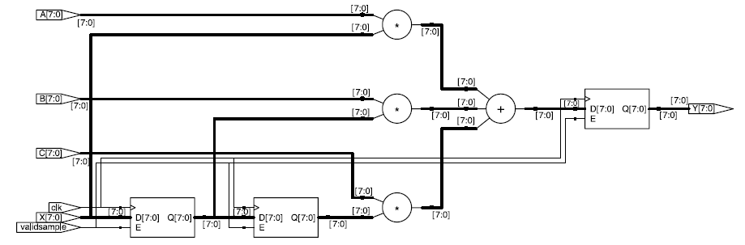
A Real Example: FIR Filter
module fir(input clk, input validsample,
output [17:0] Y, input [7:0] A, B, C, X);
reg [7:0] X1, X2, Y;
always @(posedge clk)
if(validsample) begin
X1 <= X;
X2 <= X1;
Y <= A* X+B* X1+C* X2;
end
endmodule

Slide 11
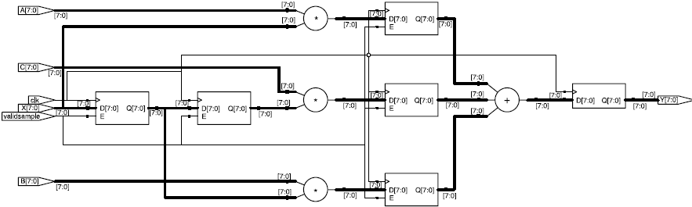
Pipelining The Filter
The critical path of one multiplier and one adder is greater than the minimum clock period requirement for registring.
Pipelining: Adder was separated from the multipliers with a pipeline stage
always @ (posedge clk) begin
if(validsample) begin
X1 <= X; X2 <= X1;
prod1 <= A * X; prod2 <= B * X1;
prod3 <= C * X2;
validsample_reg<=validsample;
end else if (validsample_reg)
Y <= prod1 + prod2 + prod3;
end

Slide 12
Problems and Conclusion
Computation depends on the result of a previous computation still in the pipeline. We should be careful of placing FF on all of edges in the cut-set.
Conclusion:
Pipelining is a tool you can use to trade area and latency for throughput.
In complex designs, you need to be careful of the above problems.

Slide 13
Pipelining Issues
As M →∞, so does your circuit area and latency.
Even if that were not true, you will reach a point where you can no longer sub-divide the design.
The flip flop clock-to-out and setup time requirements do not change and set a limit on F, as M →∞.
Your algorithm may not easily partition into M equal stages
in which case, the increase in F is set by the partition with the longest delay.
Strategy: Focus your attention on placing the pipelining flip flops to isolate the slowest piece of the design and then maintain balance.

Slide 14
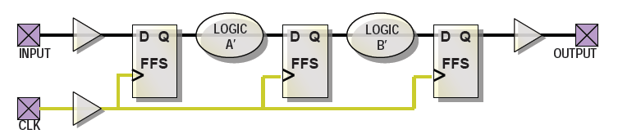
Retiming (Register Balancing)
Improving throughput by decreasing the worst-case delay → increasing F.
Redistribute logic evenly between registers to minimize the worst-case delay between any two registers.
This technique should be used whenever logic is highly imbalanced between the critical path and other paths.

Slide 15
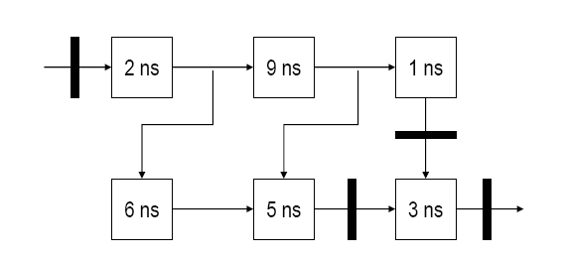
Simple Example
Solid bars represent flip flops. Assume the design flip flops.
This is an unbalanced, pipelined design.
Retime the circuit without moving the input or output flip flops.

Slide 16
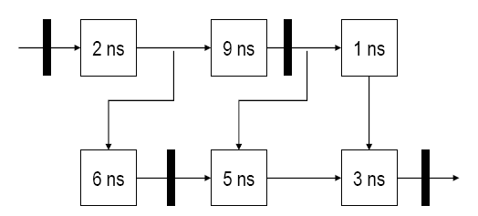
Solution
Old Latency = 32 ns (2 cycles)
Old Throughput = 1 op / 16 ns
New Latency = 22 ns (2 cycles)
New Throughput = 1 op / 11 ns

Slide 17
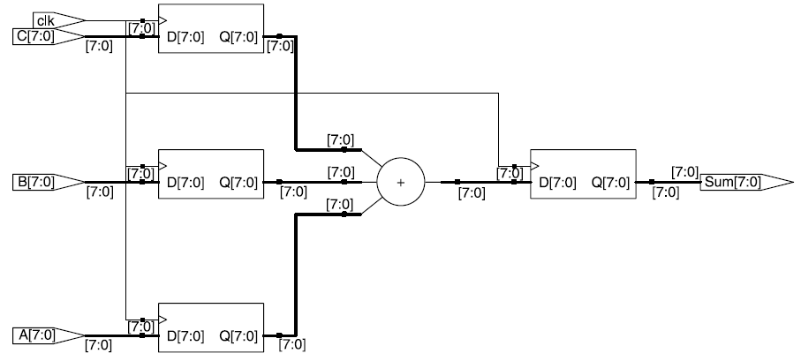
A Real Example
The logic between stages 1 and 2 is the adder for all inputs
There is no logic between the input and the first register (assume the outputs feeding this module are registered)
input [7:0] A, B, C;
reg [7:0] rA, rB, rC;
always @(posedge clk) begin
rA <= A;
rB <= B;
rC <= C;
Sum <= rA + rB + rC;
end
endmodule

Slide 18
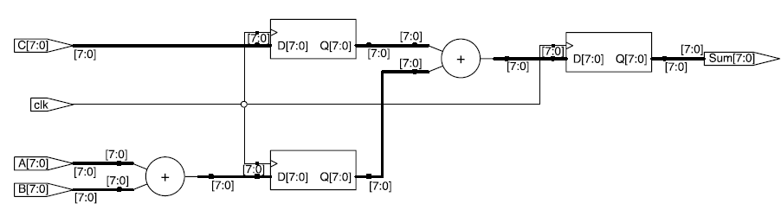
Register Balancing
We can push one of the add operations backward.
always @(posedge clk) begin
rABSum <= A + B;
rC <= C;
Sum <= rABSum + rC;
end

Slide 19
Retiming Conclusion
Retiming in many cases is not a magic tool and may gain you very little. However in some cases if the initial design is not well enough, retiming may results in substantial improvement.
The decision to use this tool to optimize your design should be based on the critical path of the design and your design constraints.
Nowadays retiming can be done in synthesis tools. However you should take care of significant design structure changes.

Slide 20
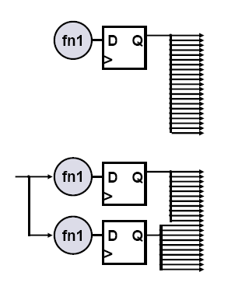
Duplicating Flip-Flops
High-fanout nets can be slow and hard to route
Duplicating flip-flops can fix both problems
Reduced fanout shortens net delays
Each flip-flop can fanout to a different physical region of the chip to help with routing
Design tradeoffs
Gain routability and performance
Design area increases

Slide 21
Duplicating Flip-Flops
Explicitly create duplicate flip-flops in your HDL code
Most synthesis tools have automatic fanout-control features
However, they do not always pick the best division of loads
Many synthesis tools will optimize-out duplicated flip-flops
Tel your synthesis tool to keep redundant logicl
(EQUIVALENT_REGISTER_REMOVAL option in XST).
We can apply attributes on specific registers or levels of hierarchy to specify which registers can or cannot be replicated.

Slide 22
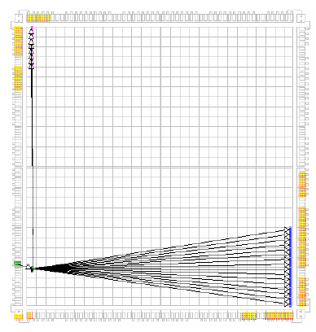
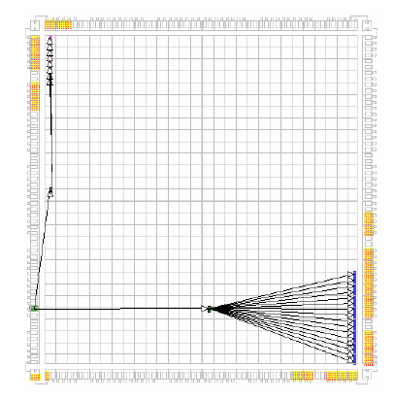
Implementation Example
PERIOD = 5 ns timing constraint
Implemented with default options
Longest path = 6.806 ns
Fails to meet timing constraint
Longest path = 4.666 ns
Meets timing constraint

Slide 23
Simple Verilog Example
Many times an additional synthesis constraint needs to be added to ensure that a manually duplicated register is not optimized away by the synthesis tool.
In this example, the XST syntax was used
(*EQUIVALENT_REGISTER_REMOVAL="NO"*) reg ce1,ce2;
// Clock enable register with 64 fanout
// Duplicating once
always @(posedge clk) begin
ce1 <= ce;
ce2 <= ce;
end
always @(posedge clk) begin
if (ce1)
res[31:0] <= a_data[31:0];
end
always @(posedge clk) begin
if (ce2)
res[63:32] <= a_data[63:32];
end

Slide 24
Resource Sharing
Resource sharing is a technique to trade frequency and latency for area.
Resource sharing is when a single hardware resource (typically area-expensive) is used to implement several operations in the design.
What kind of operations can share hardware?
Addition, Subtraction, Comparisons.
Multiplication, Division.

Slide 25
Resource Sharing Example
Assume a 16x16 multiplier uses 100 area units.
Assume a 4:1 multiplexer uses 1 area unit.
Consider the following block of code:
wire [15:0] a, b, c, d, e, f, g, h, i, j;
reg [31:0] output1, output2;
wire [1:0] op;
always @* begin
output1 = a * b;
case (op)
2’b00: output2 = c * d;
2’b01: output2 = e * f;
2’b10: output2 = g * h;
2’b11: output2 = i * j;
endcase
end

Slide 26
Resource Sharing
A simple implementation uses:
A multiplier to generate output1.
Four multipliers, followed by a 32-bit wide 4:1 multiplexer to generate output2.
Area cost is 532 area units.
A better implementation uses:
A multiplier to generate output 1.
Two 16-bit wide 4:1 multiplexers followed by a multiplier to generate output2.
Area cost is 200 + 2*16=232 area units.

Slide 27
Some Other Ideas for Timing and Area Optimization (Less Important)

Slide 28
Other Timing Optimizations Techniques
Parallel structures
Separating sequentially executed operations into parallel operations.
For example, we can break the multipliers into independent operations.
X = {A, B}
A is the 4 most significant bits
B is the 4 least significant bits
For instance : X² can be calculated as follows
X * X = {A, B} * {A, B} = {A *A , B*B} + 2*(A *B)<<4;
= {A *A , B*B} + (A *B)<<5;

Slide 29
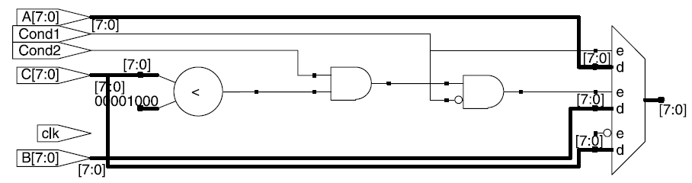
Reordering paths
Diverting operations in a critical path to a noncritical path.
Example:
module randomlogic( output reg [7:0] Out, input [7:0] A, B, C,
input clk, input Cond1, Cond2);
always @(posedge clk)
if(Cond1)
Out <= A;
else if(Cond2 && (C < 8))
Out <= B;
else
Out <= C;
endmodule

Slide 30
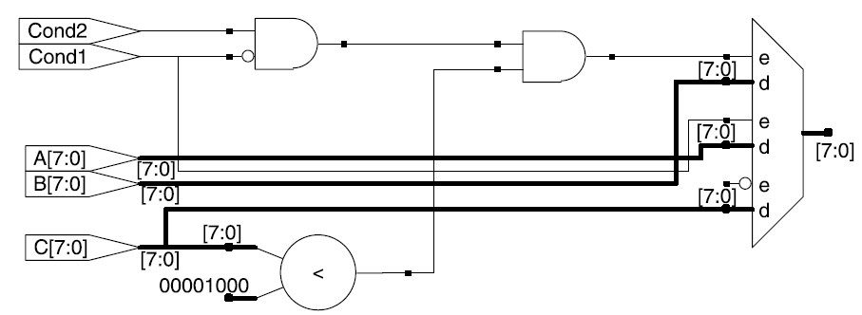
Reordering paths
Moving one of the gates out of the critical path in series with the comparator.
wire CondB = (Cond2 & !Cond1);
always @(posedge clk)
if(CondB && (C < 8))
Out <= B;
else if(Cond1)
Out <= A;
else
Out <= C;

Slide 31
IMPACT OF RESET ON AREA
There are a number of considerations to take into account relative to area when designing a reset structure.
An improper reset strategy can create an unnecessarily large design and inhibit certain area optimizations.
Resources Without Reset
Resources Without Set
Resources Without Asynchronous Reset
Resetting RAM
Utilizing Set/Reset Flip-Flop Pins

Slide 32
Resources Without Reset
Insistence on defining a global set/reset condition for every flip-flop.
Although this may seem like good design practice, it can often lead to a larger design
The reason for this is
Certain functions can be optimized according to the fine-grain architecture of the FPGA without reset input.
Bringing a reset into every synchronous element can cause the synthesis and mapping tools to push the logic into a coarser implementation

Slide 33
Resources Without Reset
There exists built-in shift-register resources in the FPGA: SRL16
No resets are defined for the SRL16 resources.
Example of a simple shift register:
IMPLEMENTATION 1 : Synchronous Reset
always @(posedge iClk)
if(!iReset) sr <= 0;
else sr <= {sr[14:0], iDat};
IMPLEMENTATION 2 : No Reset
always @(posedge iClk)
sr <= {sr[14:0], iDat};

Slide 34
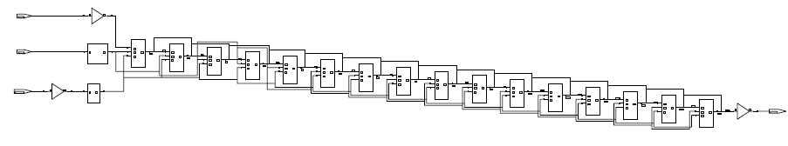
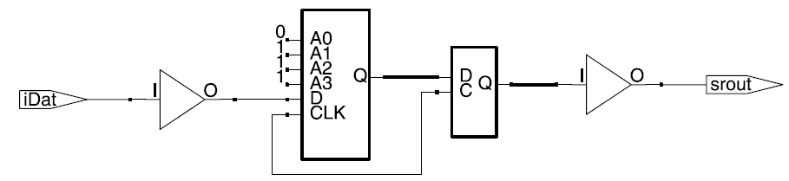

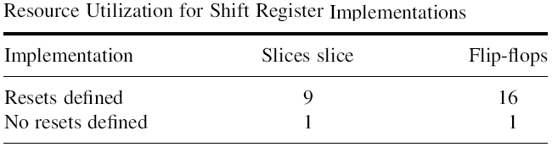
Implementation 1
Implementation 2

Slide 35
Resources Without Reset
The key here is that
if we wish to take advantage of built-in shift-register resources available in the FPGA, we will need to code it such that there is a direct mapping.
If resets are defined in our design, then the SRL16 unit could not be used as there are no reset control signals to the resource
Then, shift register would be implemented as discrete flipflops as shown in the next slide

Slide 36
Resources Without Set
Similar to the previous problem, some internal resources lack any type of set capability.
The multiplier resources in most FPGAs have built-in reset resources while they do not typically have set resources.
An example is that of an 8*8 multiplier
module mult8(
output reg [15:0] oDat,
input iReset, iClk,
input [7:0] iDat1, iDat2);
always @(posedge iClk)
if(!iReset) oDat <= 16’hffff;
else oDat <= iDat1 * iDat2;
endmodule

Slide 37
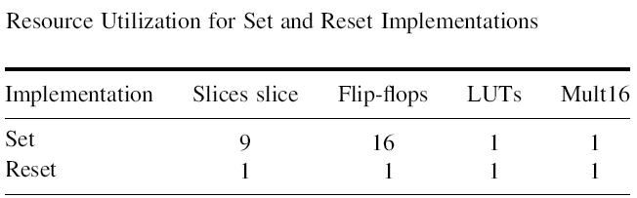
Resources Without Set
If the set functionality as described above (16’hffff instead of simply 0) is required, the used area would be much larger.
In the set scenario, an additional gate for each output is required to set the output when the reset is active.
The reset on the multiplier, in this case, will go unused.
Affects both timing and area usage.

Slide 38
Resources Without Async. Reset
Built-in DSP resources are used to multiply–accumulate functions.
The DSP structures inside a many Xilinx FPGA, for example Virtex-4 devices, have only synchronous reset capabilities.
always @(posedge iClk or negedge iReset)
if(!iReset) begin
multfactor <= 0;
oDat <= 0;
end
else begin
multfactor <= (iDat1 * iDat2);
oDat <= multfactor + oDat;
end

Slide 39
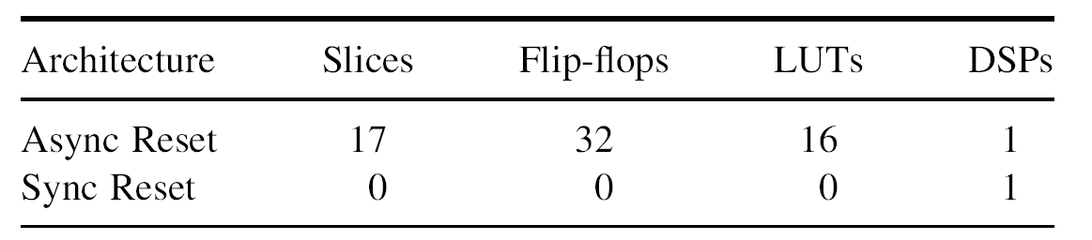
Resources Without Async. Reset
To implement an asynchronous reset, the synthesis tool must create additional logic outside of the DSP core.
Built-in RAM resources are similar to the DSP resources and often only synchronous resets are available.
Generally resetting RAM is usually poor design practice, particularly if the reset is asynchronous.

Slide 40
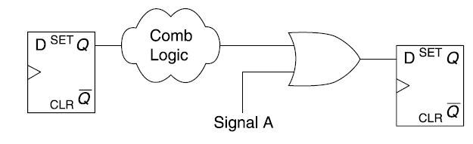
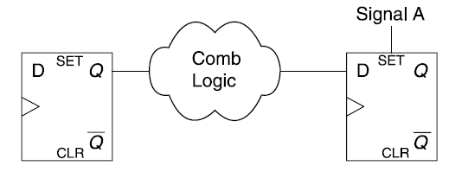
Utilizing Set/Reset Flip-Flop Pins
Given a particular logic function, the synthesis tool can often use the set and reset pins to implement aspects of the logic and reduce the burden on the look-up tables.
In this case, the synthesis tool may choose to implement the logic using the set pin on a flip-flop.

Slide 41
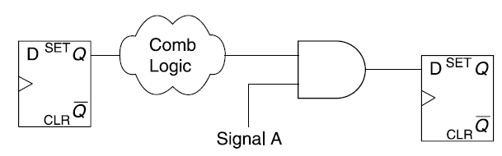
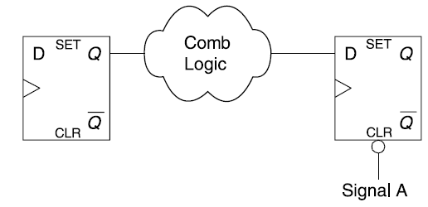
Likewise, consider a logic function of the form illustrated in this figure. The AND gate can be eliminated by running the input signal to the reset pin of the flip-flop.

Slide 42
Reset strategy may prevent synthesis tools from performing this class of optimizations.
Example:
module setreset( output reg oDat, input iReset, iClk, input iDat1, iDat2);
always @(posedge iClk or negedge iReset)
if(!iReset)
oDat <= 0;
else
oDat <= iDat1 | iDat2;
endmodule

Slide 43
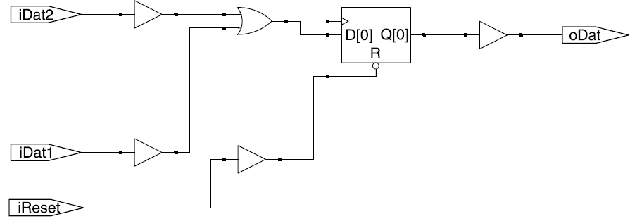
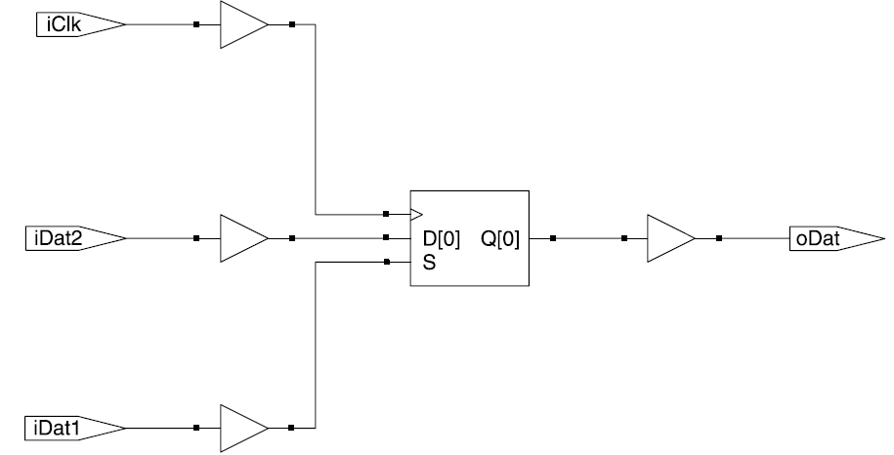
If we remove the reset pin the same logic can be optimized.

Slide 44
Moreover we can use both synchronous set and reset signals.
Assume we want to calculate:
oDat<=!iDat3 & (iDat1 | iDat2);
We can code like this to optimize the area:
always @(posedge iClk)
if(iDat3)
oDat <= 0;
else if(iDat1)
oDat <= 1;
else
oDat <= iDat2;

Slide 45
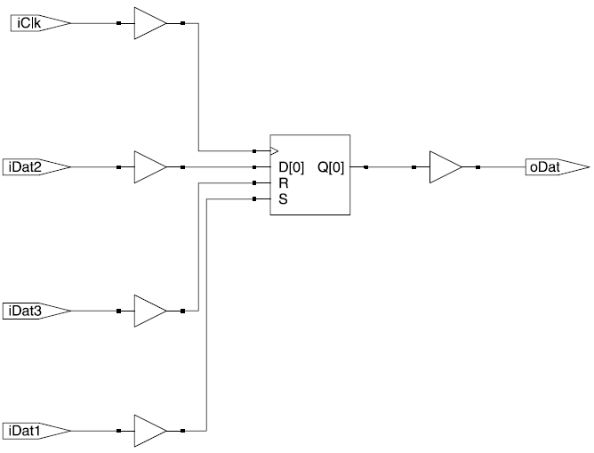
It is not recommended to optimize in this way unless when area is the key consideration

Slide 46
Simple Example On Pipelining: unrolling the loop
Calculating the 3rd power of X : X^3
Assume 8 bit input.
Software Implementation
XPower = 1;
for (i=0;i < 3; i++)
XPower = X * XPower;
There is no use for parallelism because a microprocessor only executes one instruction at a time (single core processor)

Slide 47
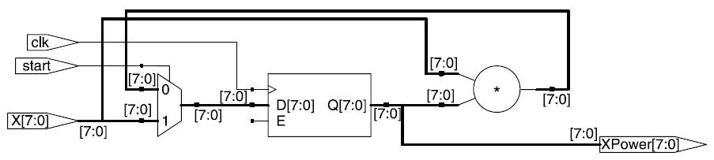
iterative implementation
input [7:0] X; input start; reg [7:0] XPower;
always@(posedge clk)
if(start) begin
XPower <= X;
ncount <= 2;
end else if (ncount !== 0) begin
ncount <= ncount - 1;
XPower <= XPower * X;
end

Slide 48
iterative implementation
Throughput: 8/3, or 2.7 bits/clock
Latency: 3 clocks
Timing: One multiplier delay in the critical path
With this type of iterative implementation, no new computations can begin until the previous computation has completed
This iterative scheme is very similar to a software implementation
Certain handshaking signals are required to indicate the beginning and completion of a computation

Slide 49
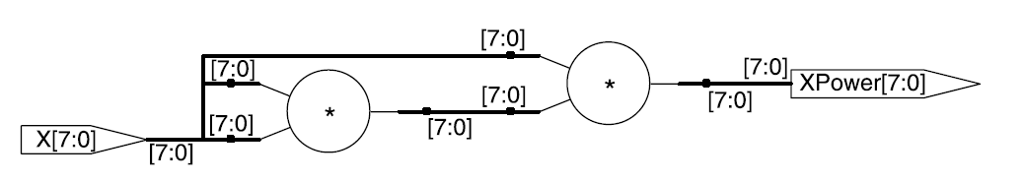
Low Latency Solution
Low Latency Solution:
always @* begin
XPower1 = X;
XPower2 = XPower1*X;
end
always @(posedge clk) begin
XPower = XPower2 * X;
end
Throughput: 8 bits/clock (assuming one new input per clock)
Latency: Two multiplier delays, 1 clock
Timing: Two multiplier delays in the critical path

Slide 50
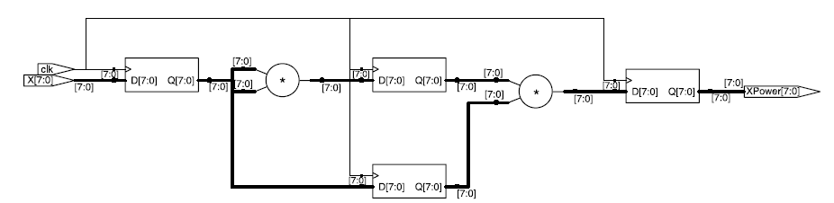
Pipelined Implementation
always @(posedge clk) begin
// Pipeline stage 1
XPower1 <= X;
X_reg2 <= XPower1;
// Pipeline stage 2
XPower2 <= XPower1 * XPower1;
// Pipeline stage 3
XPower <= XPower2 * X_reg2;
end
Throughput: 8/1, or 8 bits/clock
Latency: 3 clocks
Timing: One multiplier delay in the critical path

Slide 51
Comparison
Comparing pipeline with iterative implementation:
Both of them have 3 clocks latency
Both of them have the similar critical path, contained only one multiplier.
Pipelined implementation improves throughput by a factor 3.
Pipeline implementation needs more area in this example

Slide 52
Comparison
Comparing pipeline with low latency implementation:
Both of them needs same area unless the registers.
Latency can be reduced by removing pipeline registers, the penalty is clearly in the timing
Pipeline implementations could theoretically run the system clock period close to the delay of a single multiplier
In the Low-latency implementation, the clock period must be at least two multiplier delays (depending on the implementation) plus any external logic in the critical path.

